Slide 1
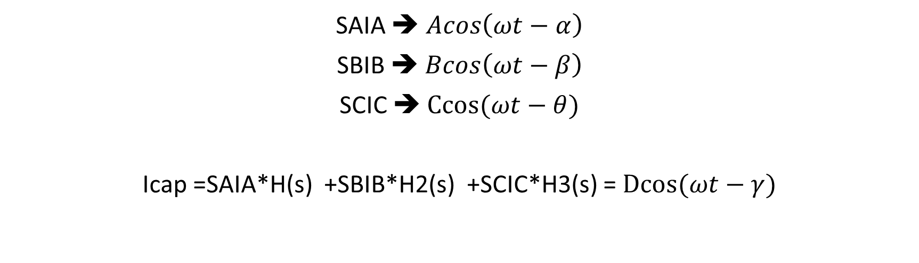
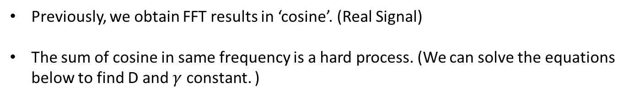
Previously, we obtain FFT results in ‘cosine’. (Real Signal)
The sum of cosine in same frequency is a hard process. (We can solve the equations below to find D and $γ$ constant. )
SAIA ➔ $Acos\left(ωt−α\right)$
SBIB ➔ $Bcos\left(ωt−β\right)$
SCIC ➔ $Ccos(ωt−θ)$
Icap =SAIA*H(s) +SBIB*H2(s) +SCIC*H3(s) = $Dcos(ωt−γ)$

Slide 2

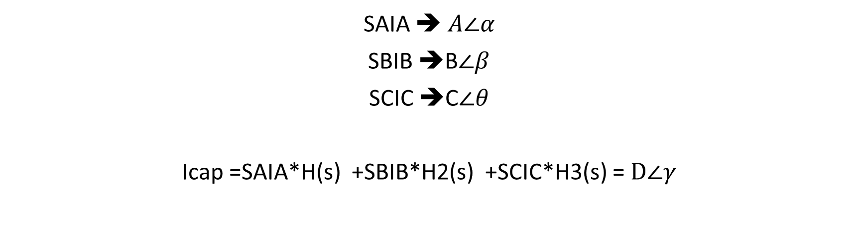

Now, we take FFT results in exponential. (The results include negative and positive frequency)
SAIA ➔ $A∠α$
SBIB ➔B$∠β$
SCIC ➔C$∠θ$
Icap =SAIA*H(s) +SBIB*H2(s) +SCIC*H3(s) = $D∠γ$
The equations above is easy to implement and find D and $γ$.
SAIA ➔ $A∠α=A∗exp⁡(j∗α)$
SBIB ➔B$∠β$ =B$∗exp⁡(j∗β)$
SCIC ➔C$∠θ$ =C$∗exp⁡(j∗θ)$
$D∠γ=A_{p}∠α_{p}$+ $B_{p}∠β_{p}$+ $C_{p}∠θ_{p}$

Slide 3
DATA and RESULTS
The results are taken in small sepeations near the harmonics of carrier.
The max harmonics are chosen as 7.
For smaller harmonic, simulation result and parasitic model are almost same. While increasing frequency, we observe some differences.

Slide 4
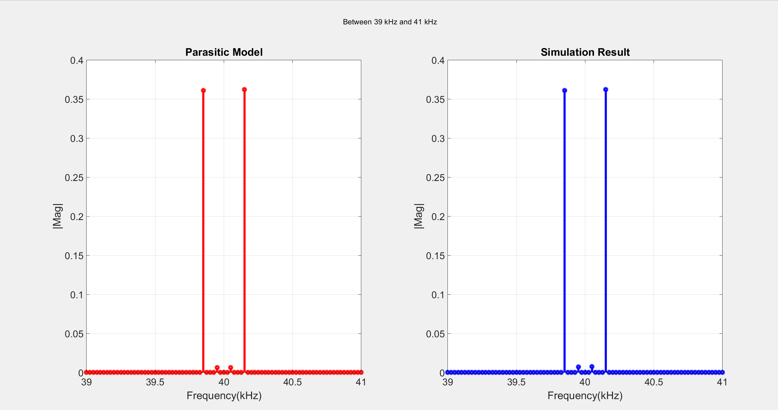

Slide 5
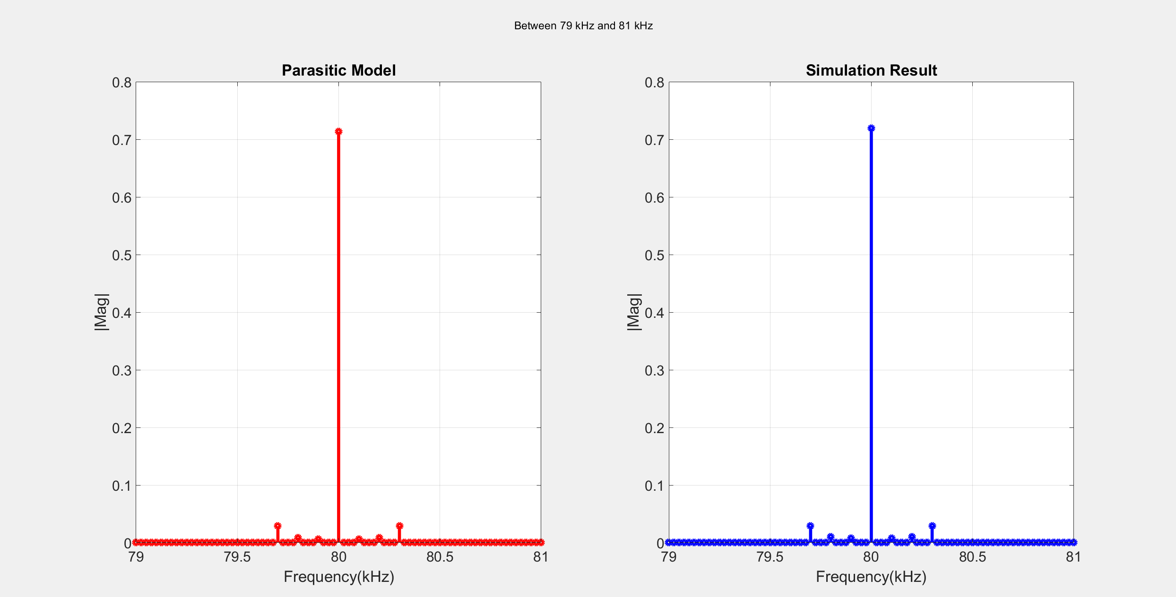

Slide 6
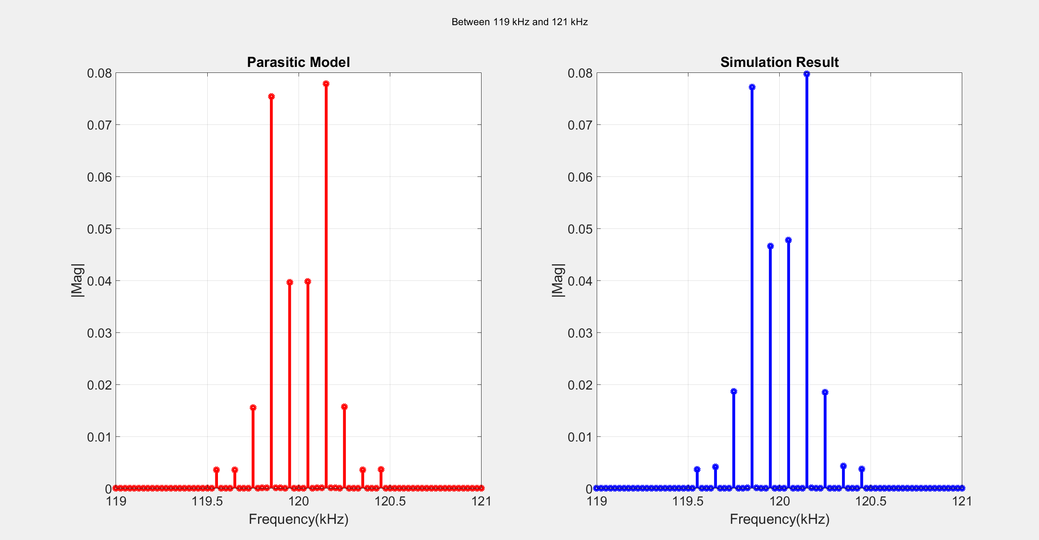

Slide 7
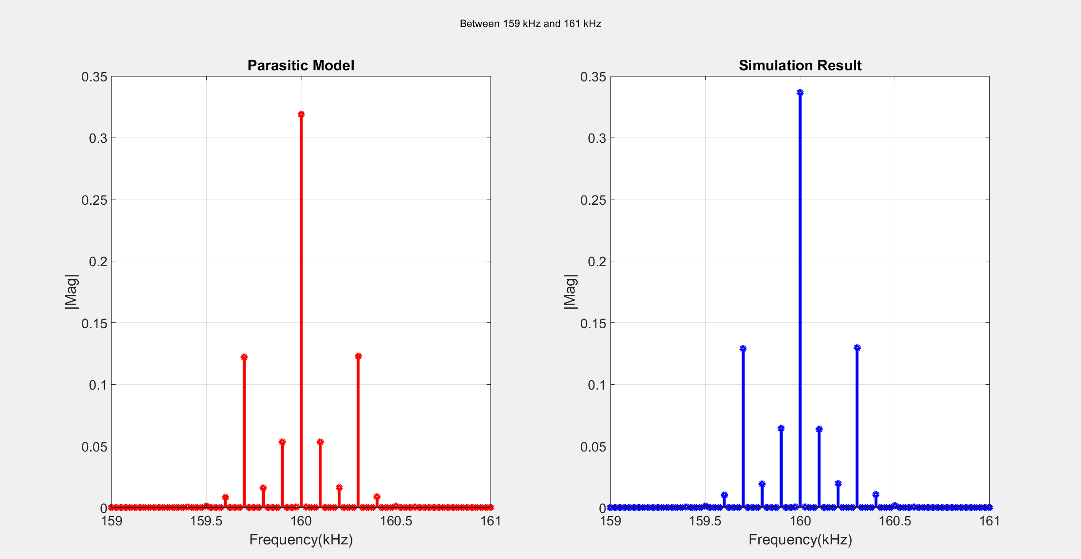

Slide 8
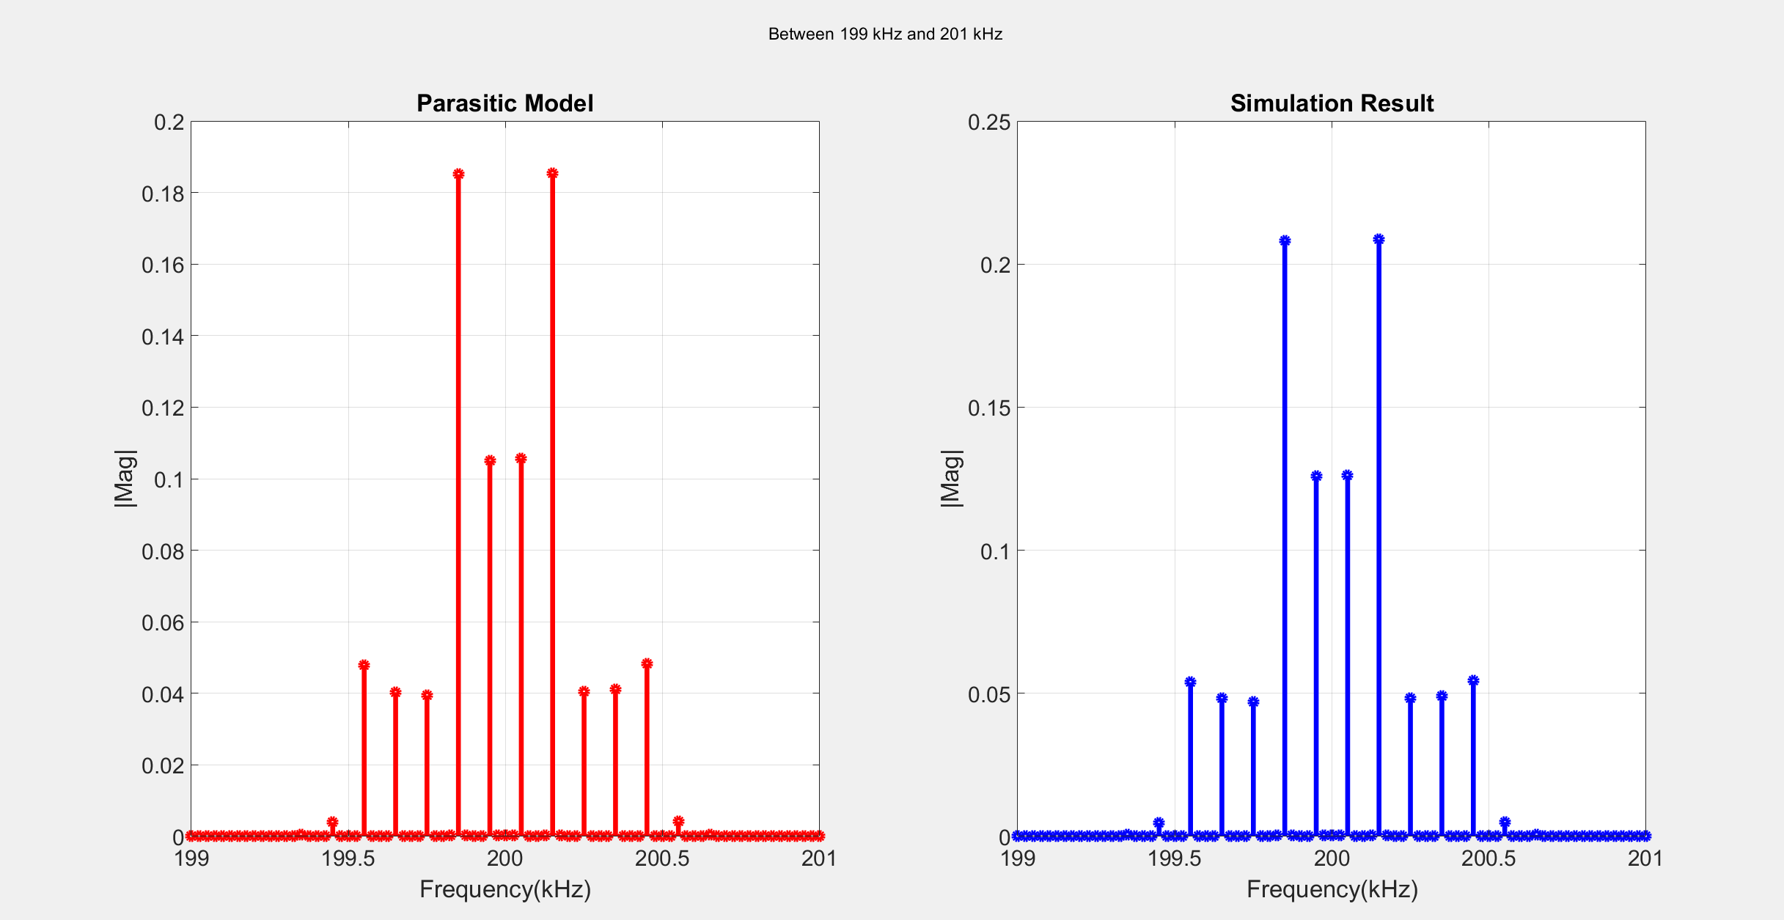

Slide 9
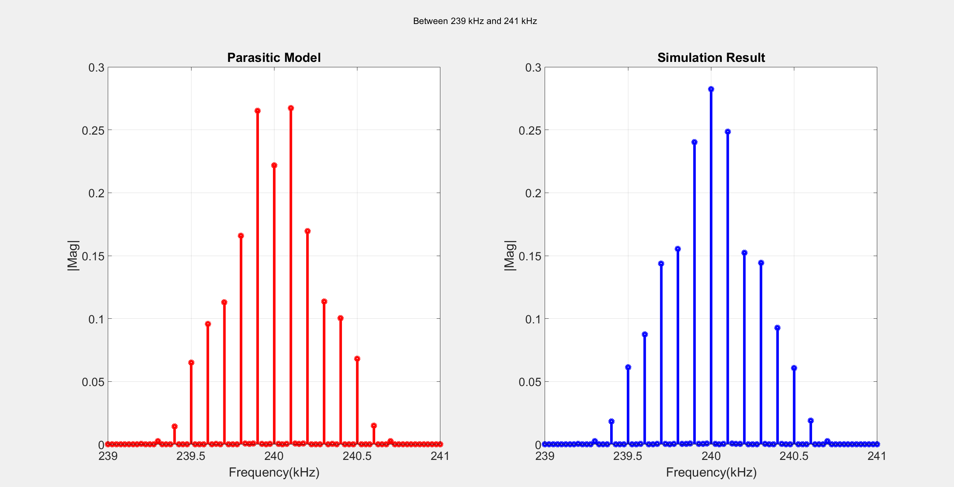

Slide 10
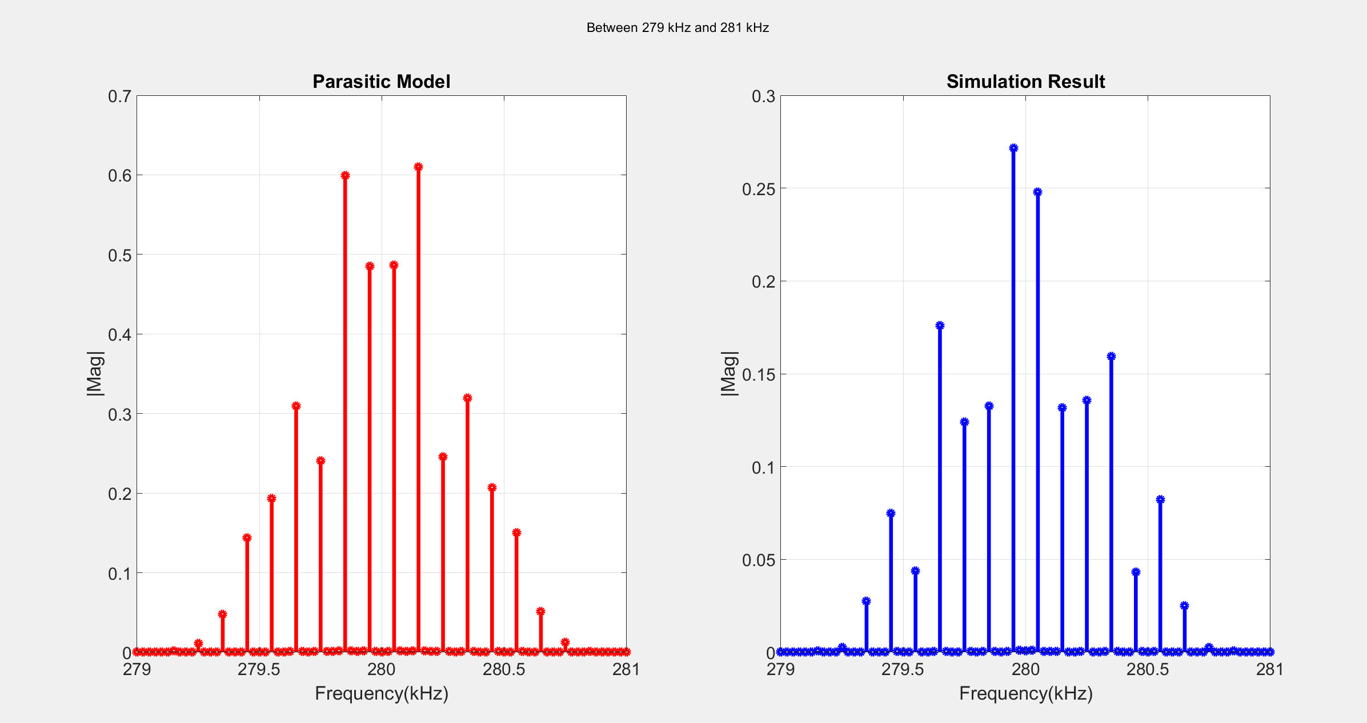

Slide 11
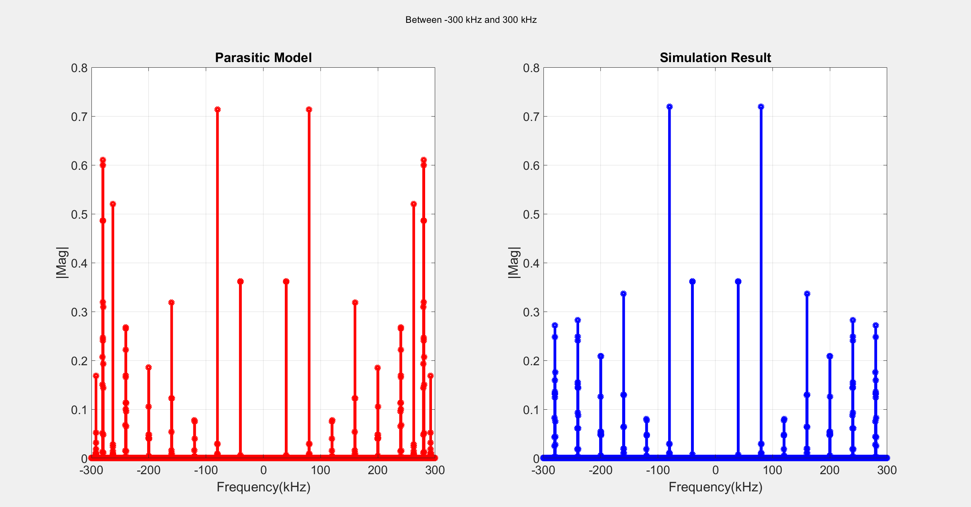

Slide 12
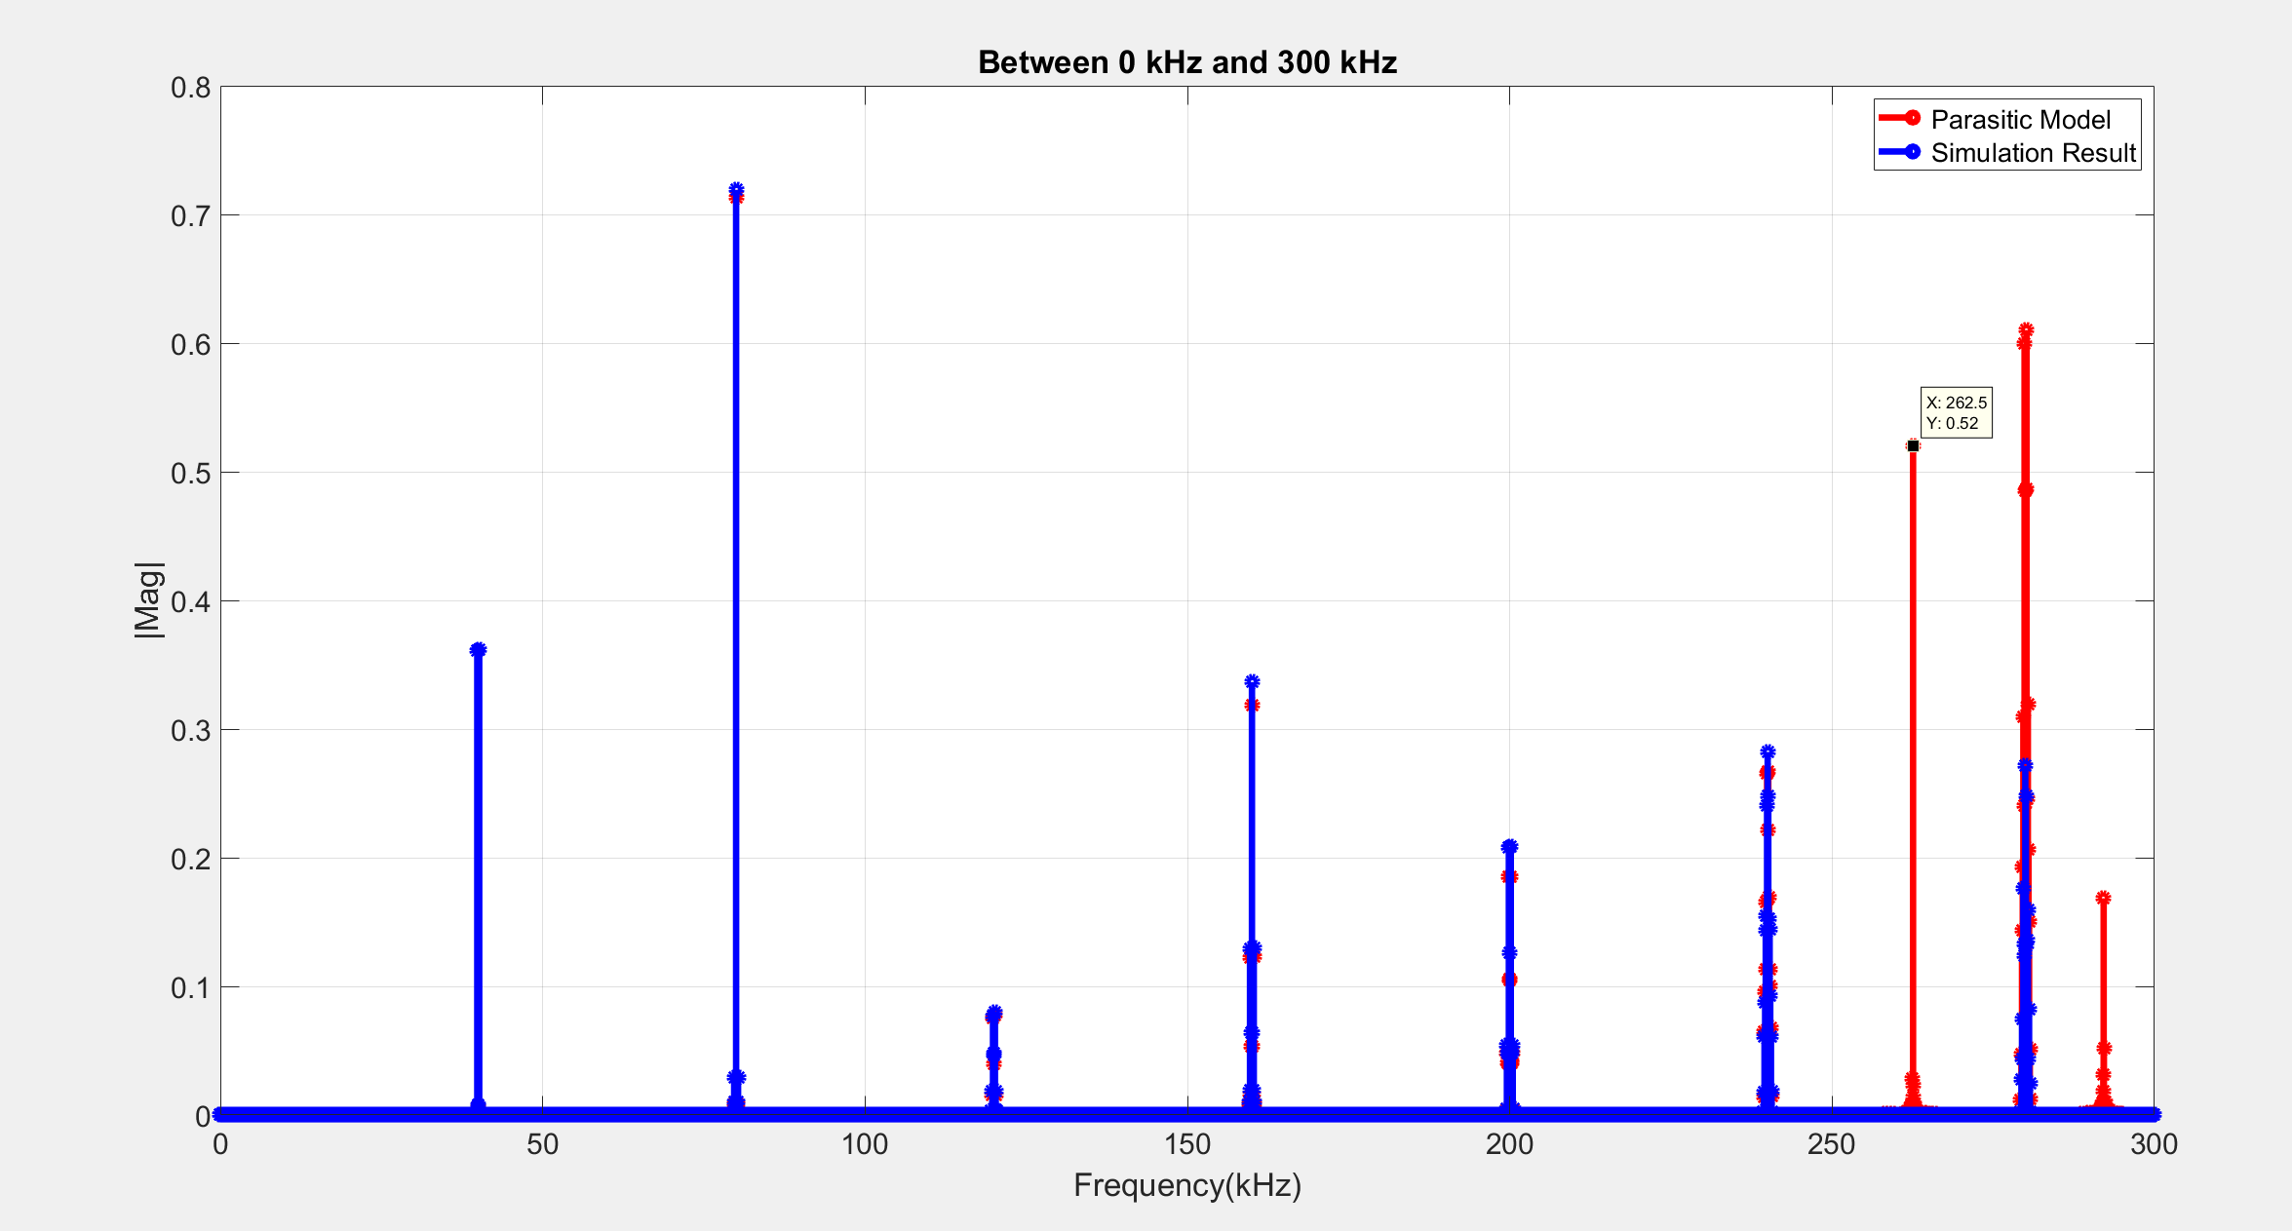

Slide 13
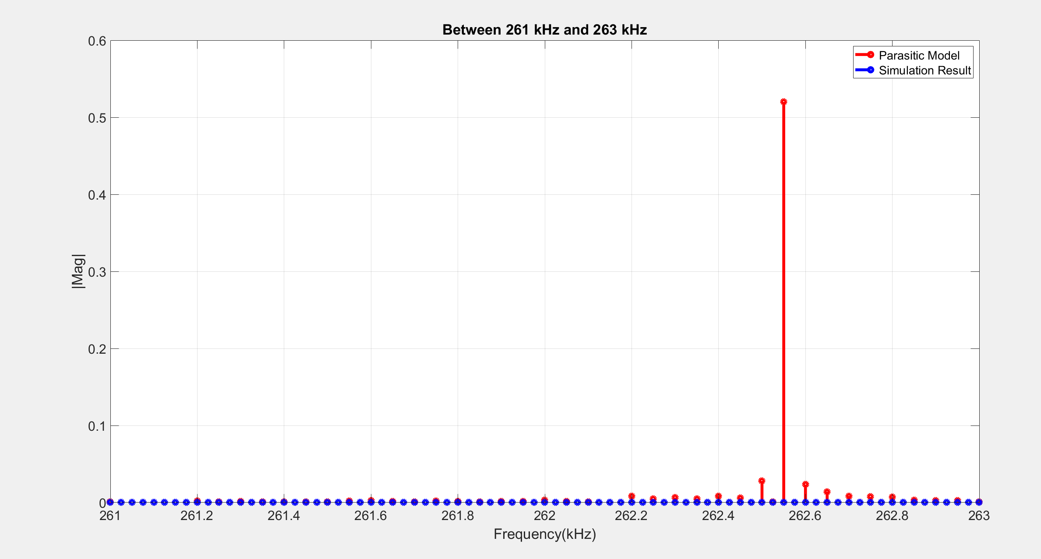

Slide 14
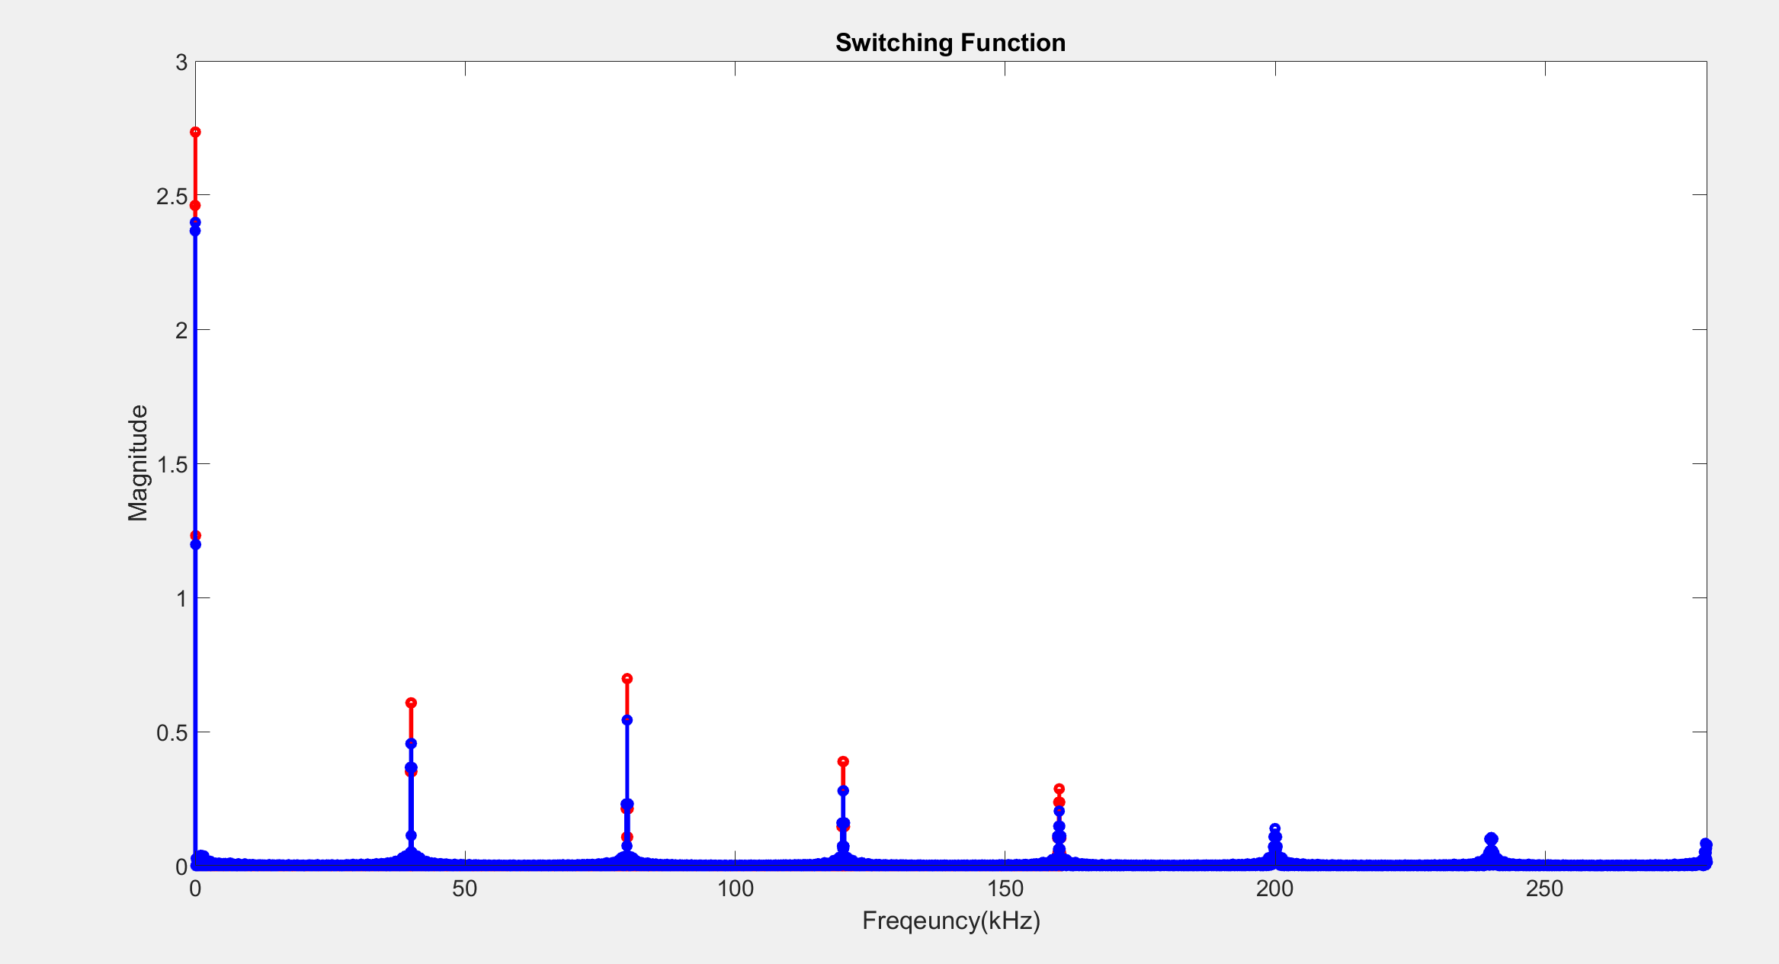
SWITCHING FUNCTION

Slide 15
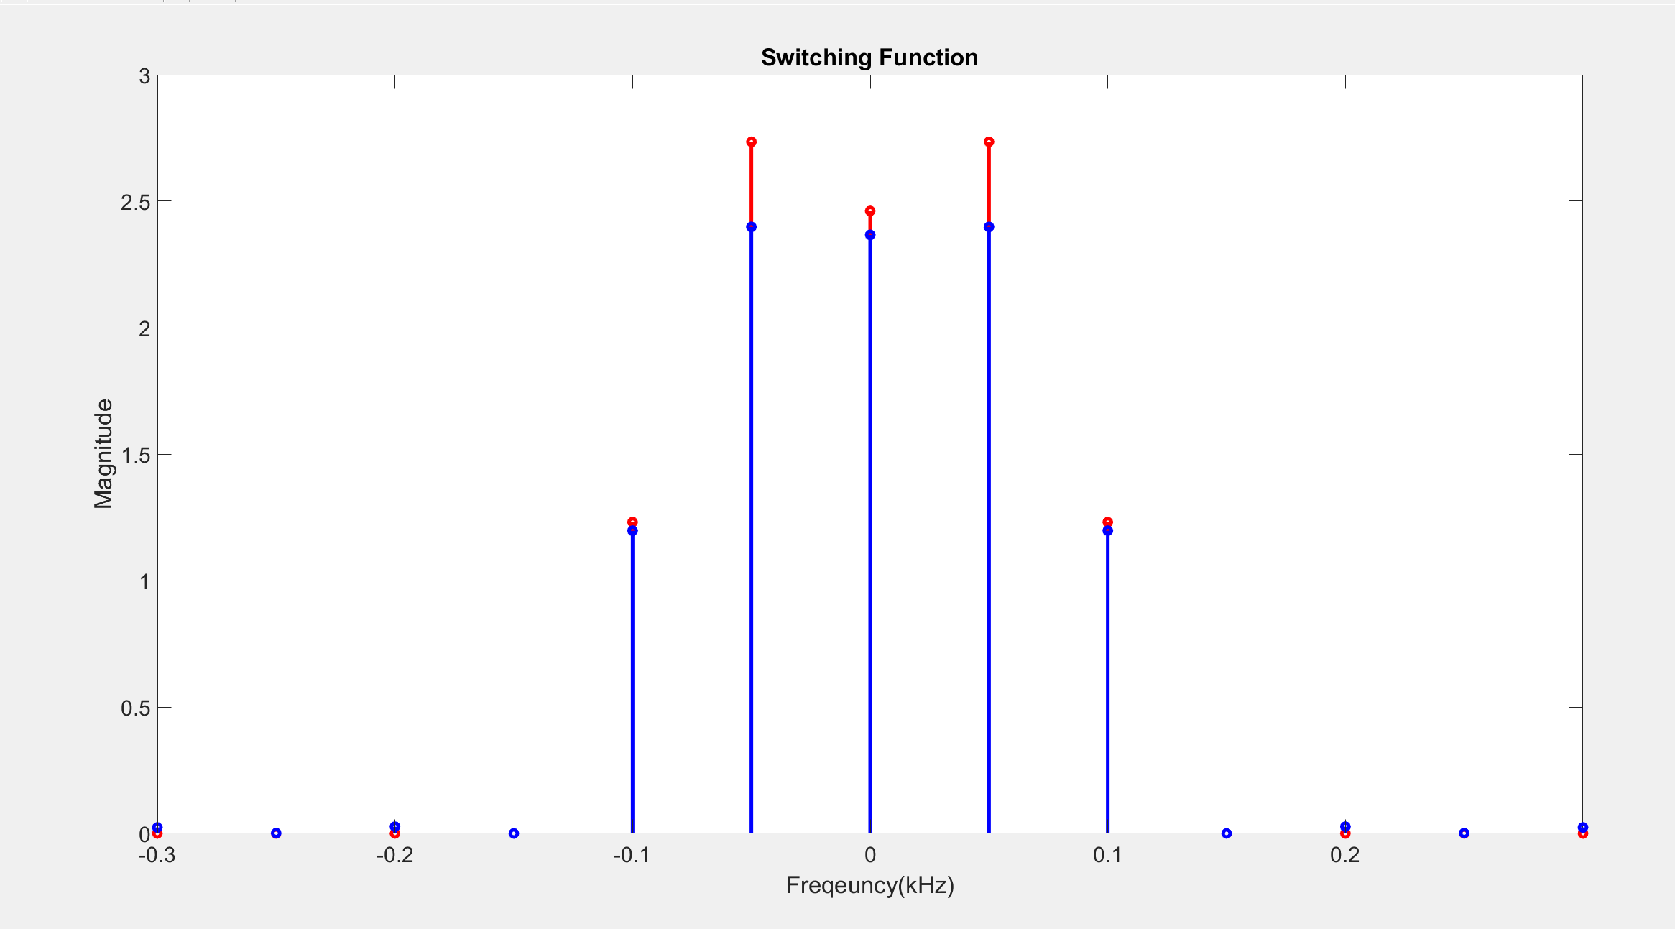

Slide 16
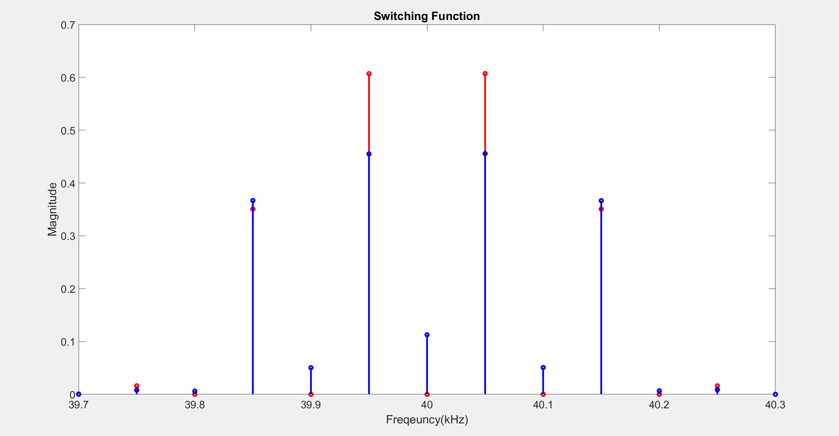

Slide 17
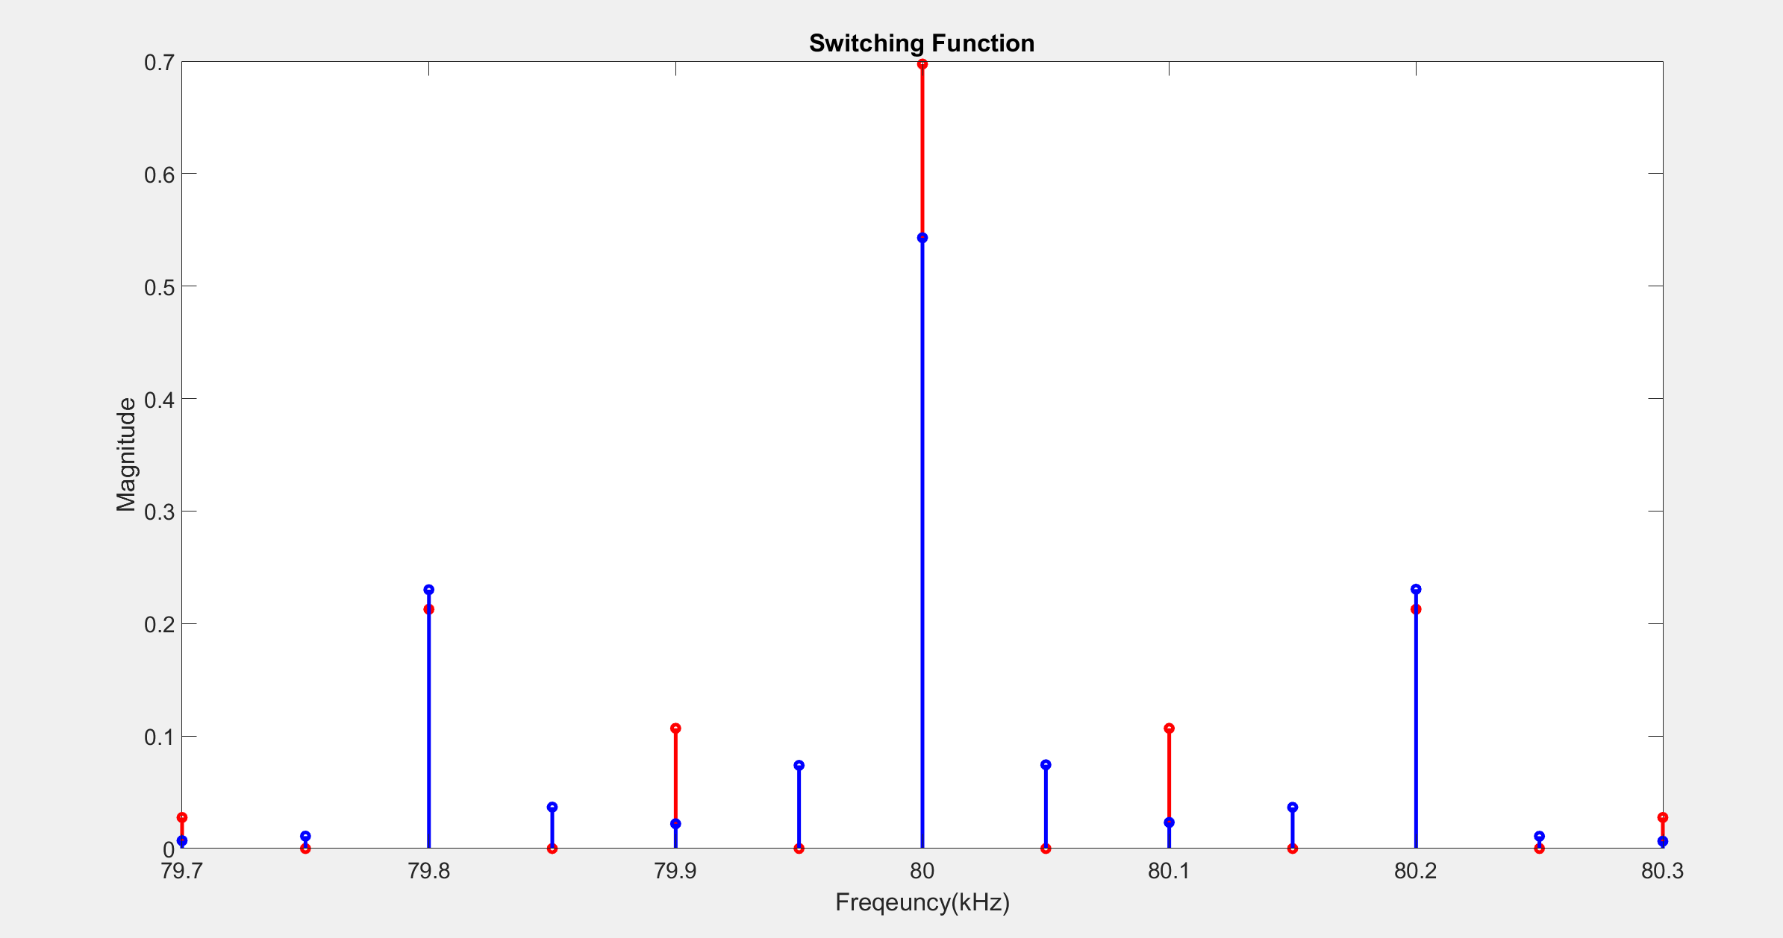

Slide 18
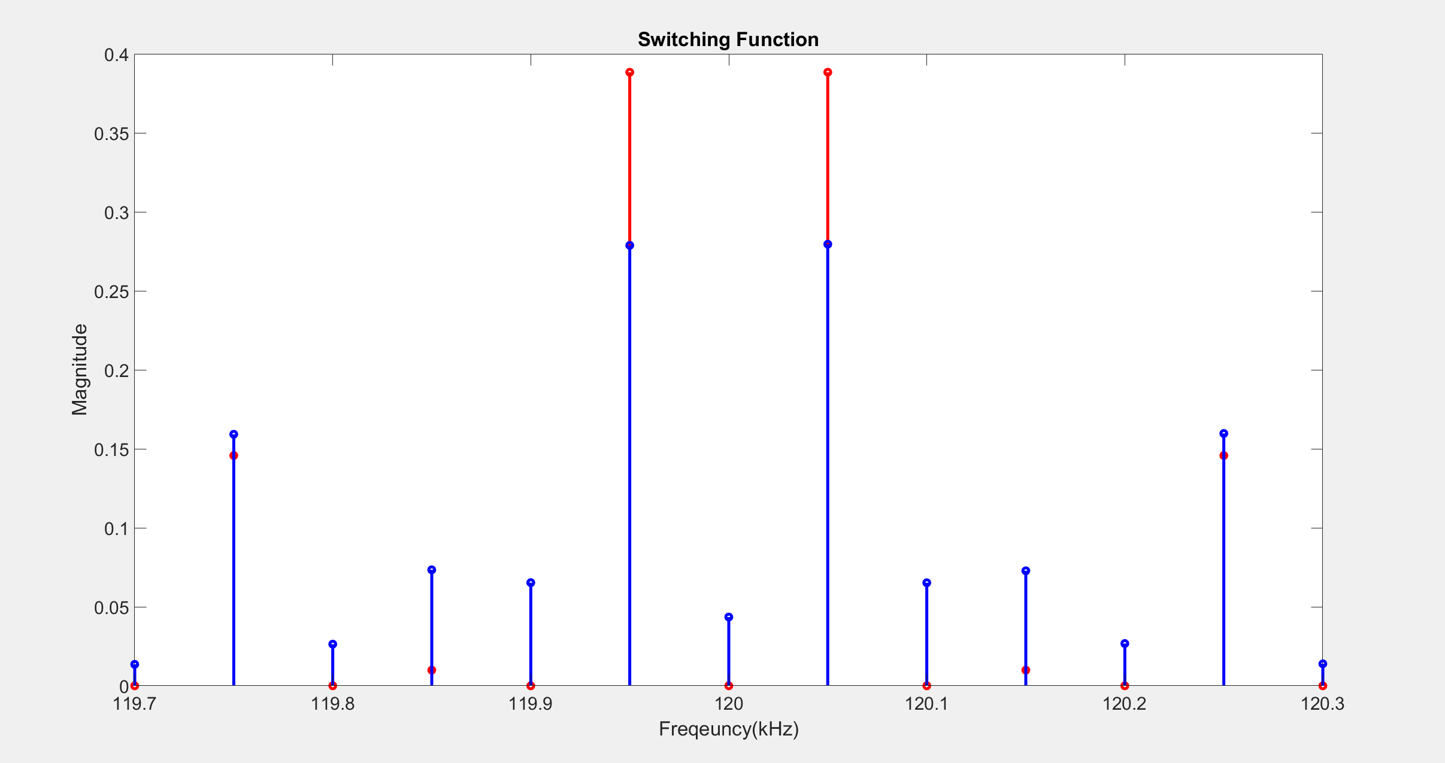

Slide 19
